Slide 1
Milestone 1 - Advanced Excel and SQL – Salary Data Analysis
Rohinth Shanmugasundaram
DADS, August Batch B

Slide 2
Introduction:
The Motive of the project is to do
data cleaning through the help of Excel and
aggregate data with the help of SQL,
building pivot tables and dashboards with the help of advanced excel functions.

Slide 3
Dataset Overview:
Industry: The sector or field in which the individual works.
Annual Salary: The individual's annual salary or earnings.
Additional Monetary Compensation: Extra earnings beyond the base salary (e.g., bonuses, commissions).
Currency: The currency in which the salary and compensation are reported.
Highest Level of Education Completed: The highest degree or educational level attained by the individual.
Gender: The gender identity of the individual.

Slide 4
Objective:
The Objective of the project is to provide insights on
Popular industries.
Relevance of college degree in annual salary.
How different genders are performing in different industries.

Slide 5
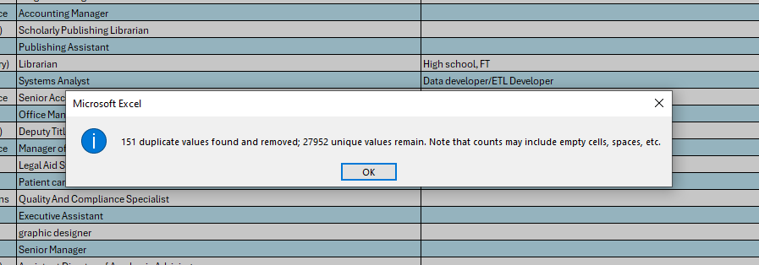
Data Cleaning and Pre Processing:
Removing Duplicates:
There were 151 duplicates in the dataset, they were removed with the help of “Remove Duplicates” function in the Excel.

Slide 6
Removing Columns:
Removing columns that are having higher missing value percentages. For example, the columns –
‘Clarification of Job title’,
‘Other Currency’,
‘Income Clarification’
have missing values more than 50 percentage hence those columns were deleted from the dataset.

Slide 7
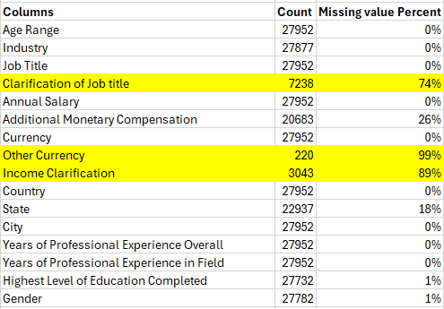

Slide 8
Removing Rows:
There are anomalies present in each of the columns – to present cleanest part for data analysis – removing such rows.
For Example, the column – ‘Job Title’ have hyphens and irrelevant titles like ‘mum’ so those rows are removed.
The column city should have texts but it contains – numbers and hyphens, so such rows are removed.

Slide 9
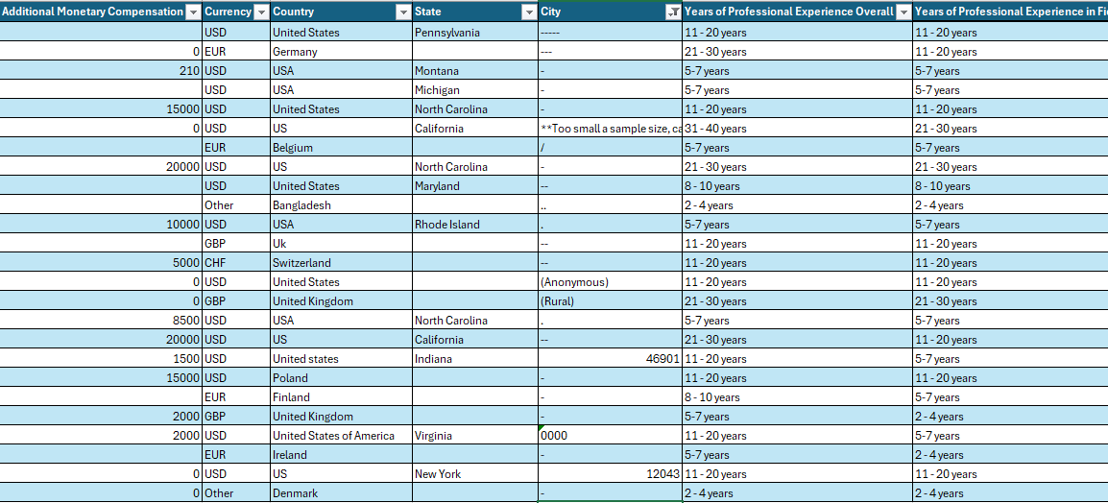

Slide 10
Data Interpolation:
The column country has different variation of each county names – for example the country – United States have variations like, USA, US, us and states. Lot of such variations were present irrespective of the case.
So, filtering them and making them consistent with respect to the wording’s spacings and cases.
The same thing happened in currency were for New Zealand and Australia had similar currency like AUD/NZD, so they were filtered and AUD is replaced for Australia and NZD is replaced for New Zealand.

Slide 11
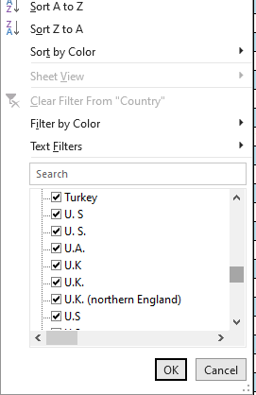
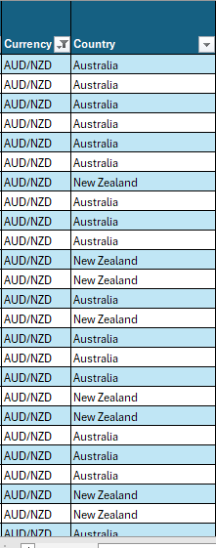

Slide 12
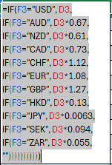
Preprocessing:
To go through with the analysis especially aggregating data based on salary – it is important for us to make the currencies similar, hence USA is the most popular country in the dataset so changing every other currency with the conversion formula,

Slide 13
SQL Query:
The dataset is further uploaded in a database called World and the data is imported.
Each of the queries have been applied and the results are exported as a csv files.
It is made sure that the data is not limited for the results.

Slide 14
SQL Query:
SELECT Gender, ROUND (100.0 * SUM (CASE WHEN `Additional Monetary Compensation in USD` > 0 THEN 1 ELSE 0 END) / COUNT (*),2) AS percentage_of_add_comp
FROM salaryanalysis
GROUP BY Gender;
Here in the query, when the compensation is greater than zero it is counted and interpolated to 1 or else zero, these ones are counted to analyze them as percentages of compensation across gender.

Slide 15
Relationships:
The columns are queried, and now they don’t belong to the same data table, so relationships must formed, so that pivot tables, charts and slicers can be connected and the dashboard can be interactive and visually appealing.
For Example, the table with gender and percentage of people that had add compensation, has unique gender data so they can form one to many relations with relevant tables.

Slide 16
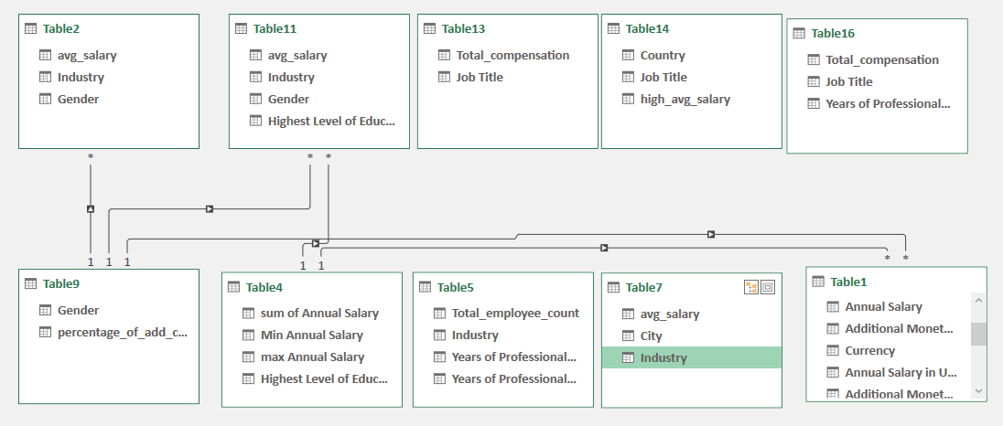

Slide 17
Pivot Tables and charts:
These Tables are created through power pivot, they were formed from the connected tables only, so that the final result can be interactive.
Finally – The slicers will be connected with all the pivot tables analyzed.

Slide 18
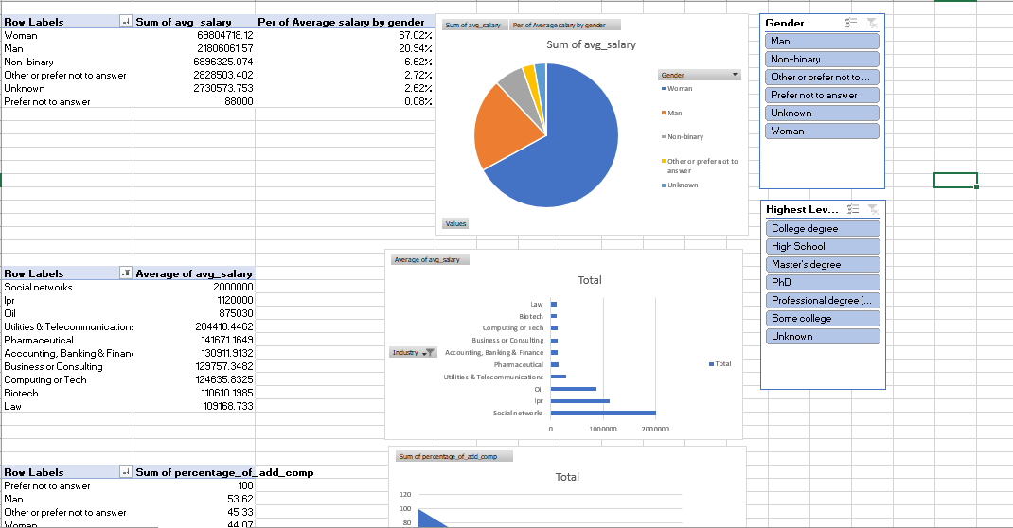

Slide 19
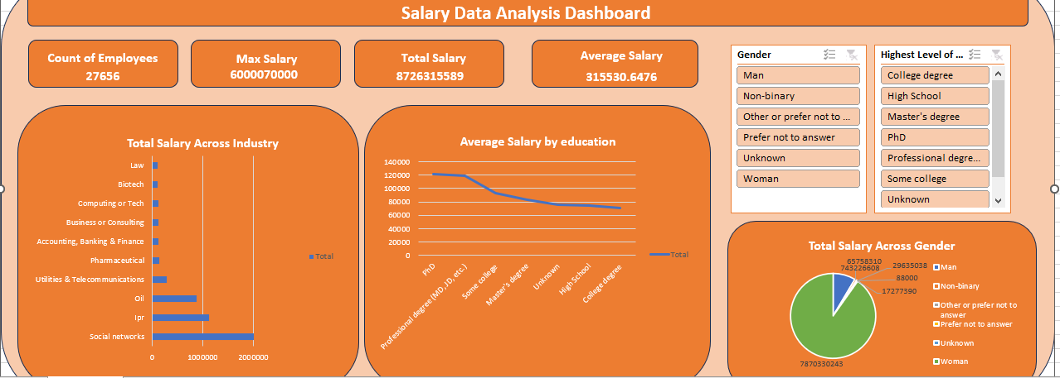
Dashboard:

Slide 20
Insights:
The peoples with highest levels of education – like PHD and professional degree have higher annual average salary of about 120 thousand dollars per annum.
The trend seems to increase for master’s degree which is above 80 thousand dollars per annum.
Social Network as an industry have contributed around about 2 million dollars a year.
IPR – The Intellectual Property Right provides salary of more than 1 million dollars.

Slide 21
Insights:
PHD being the highest average salary – slicing it women contribute about 65 percent in that salary.
Men have performed very well in utilities and telecommunication industry having average salary greater than 160 thousand dollars
Women have performed very well in IPR industry with the average salary of below 120 thousand dollars.

Slide 22
Recommendations:
From the above insights we could say that people with higher levels of education, have higher salary, so people those who need improved salary range should constantly upskill themselves.
Social Networks, IQR and Oil have been recognized as fields with high potential based on the above data, so persons who would consider reliability and job security can consider entering those fields.
Women have especially performed well in IQR industry, so encouraging especially students to explore such industry.
men have especially performed well in utilities and telecommunication industry, so encouraging especially students to explore such industry.

